Slide 1
Professional Ethics
Vivek Garg
Asst. Prof. CSVTU Bhilai

Slide 2
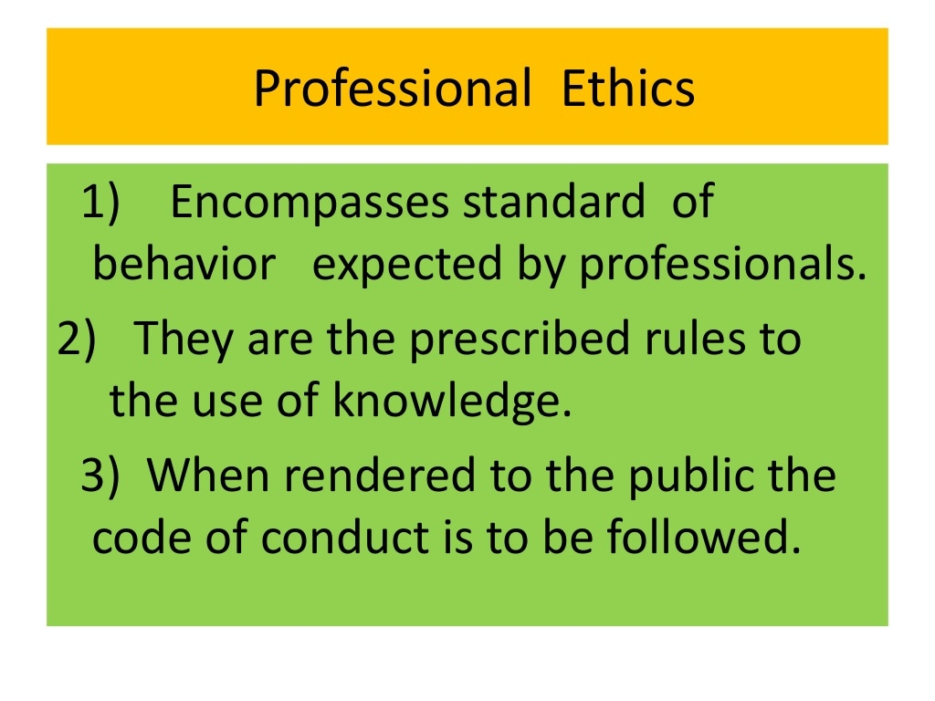

Slide 3
Professional Ethics
Ethics is the word that refers to morals, values, and beliefs of the individuals, family or the society. The word has several meanings. Basically it is an activity and process of inquiry. Secondly, it is different from non-moral problems, when dealing with issues and controversies. Thirdly, ethics refers to a particular set of beliefs, attitudes, and habits of individuals or family or groups concerned with morals. Fourth, it is used to mean ‘morally correct’.
The study on ethics helps to know the people’s beliefs, values, and morals, learn the good and bad of them, and practice them to maximize their well-being and happiness. It involves the inquiry on the existing situations, form judgments and resolve the issues. In addition, ethics tells us how to live, to respond to issues, through the duties, rights, responsibilities, and obligations. In religion, similar principles are included, but the reasoning on procedures is limited.
The principles and practices of religions have varied from to time to time (history), region (geography, climatic conditions), religion, society, language, caste and creed. But ethics has grown to a large extent beyond the barriers listed above. In ethics, the focus is to study and apply the principles and practices, universally

Slide 4
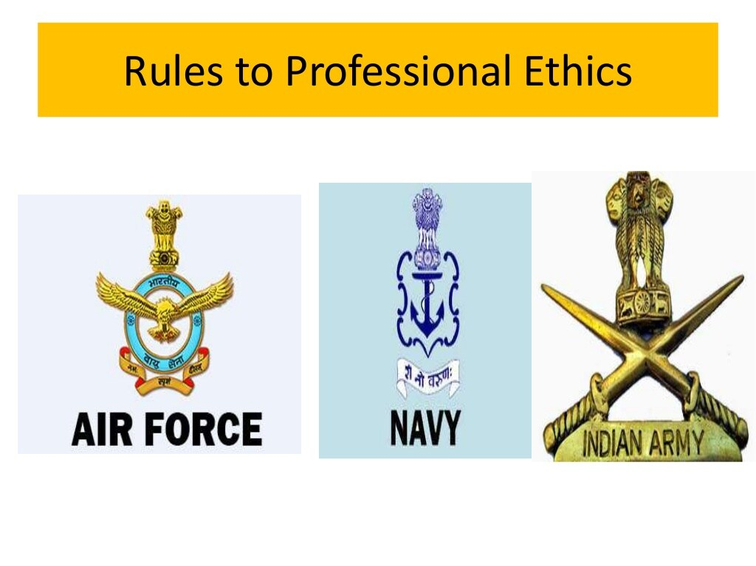

Slide 5
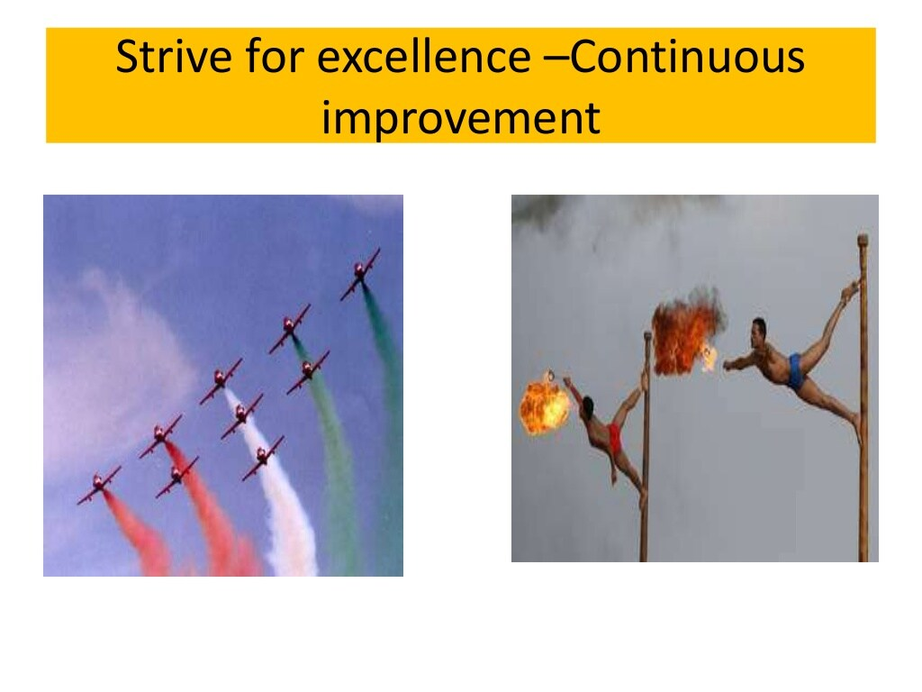

Slide 6
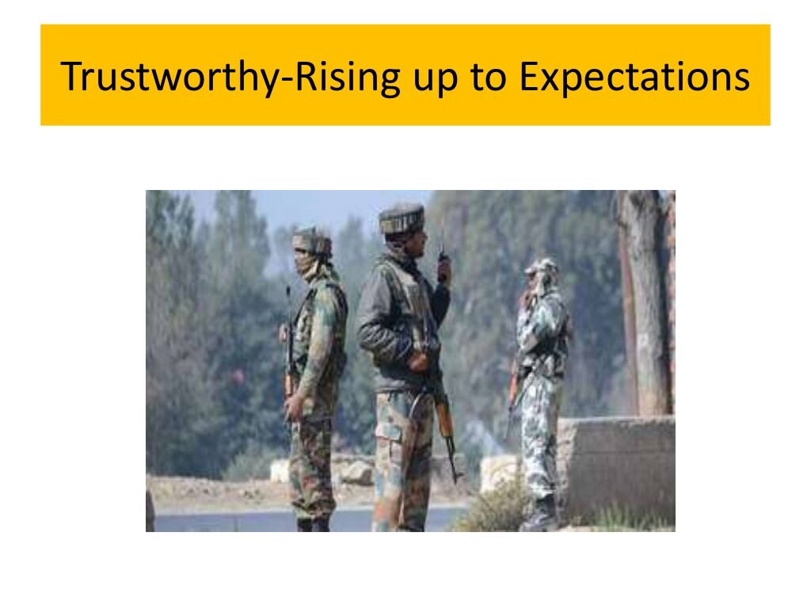

Slide 7
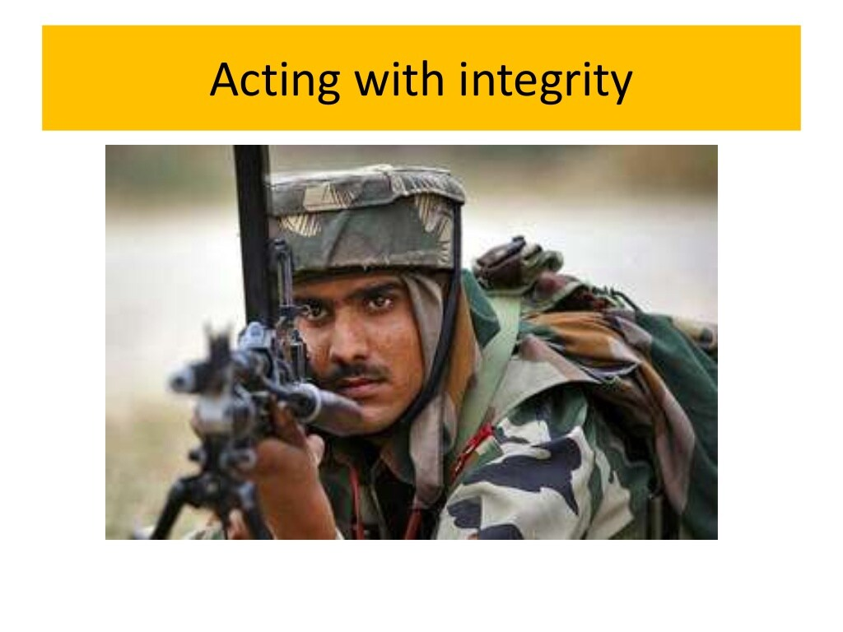

Slide 8
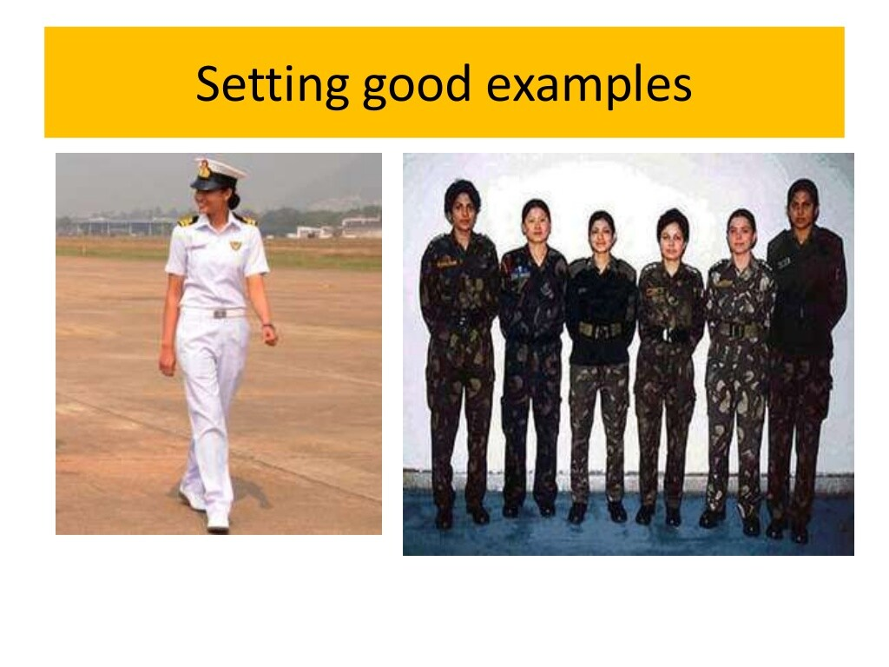

Slide 9
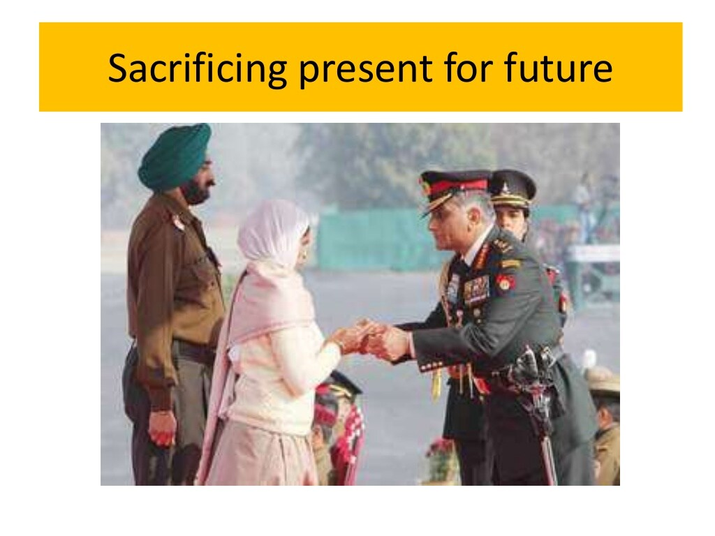

Slide 10
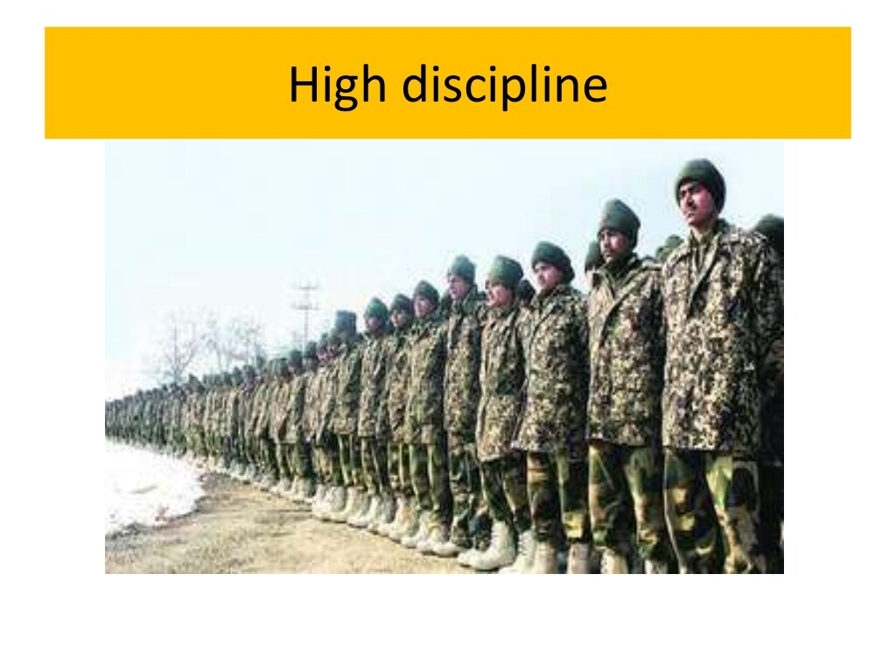

Slide 11
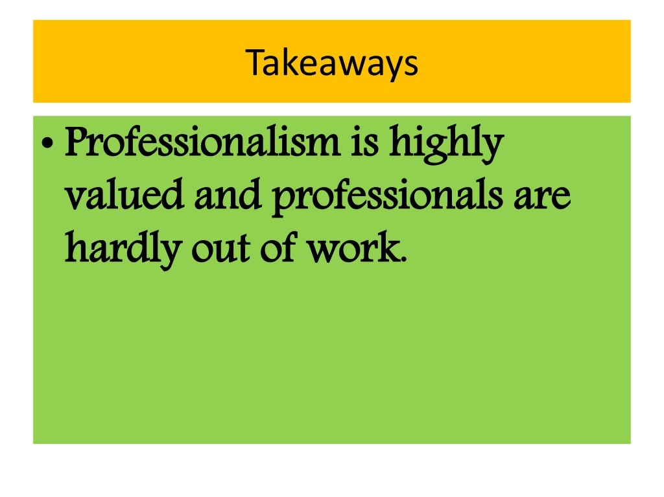

Slide 12
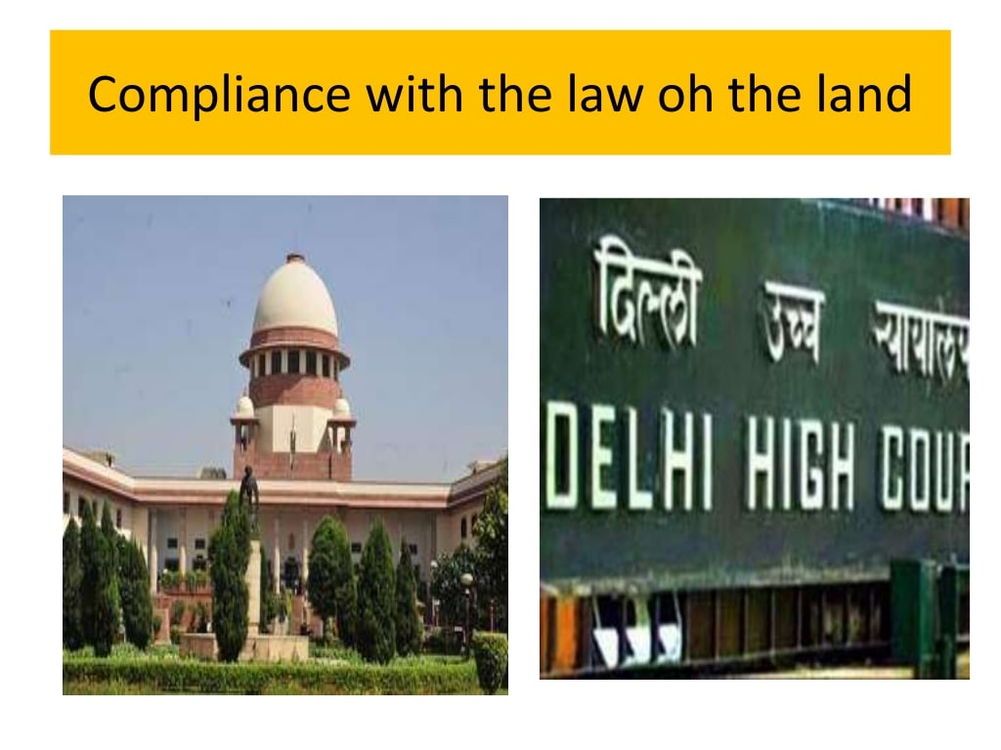

Slide 13
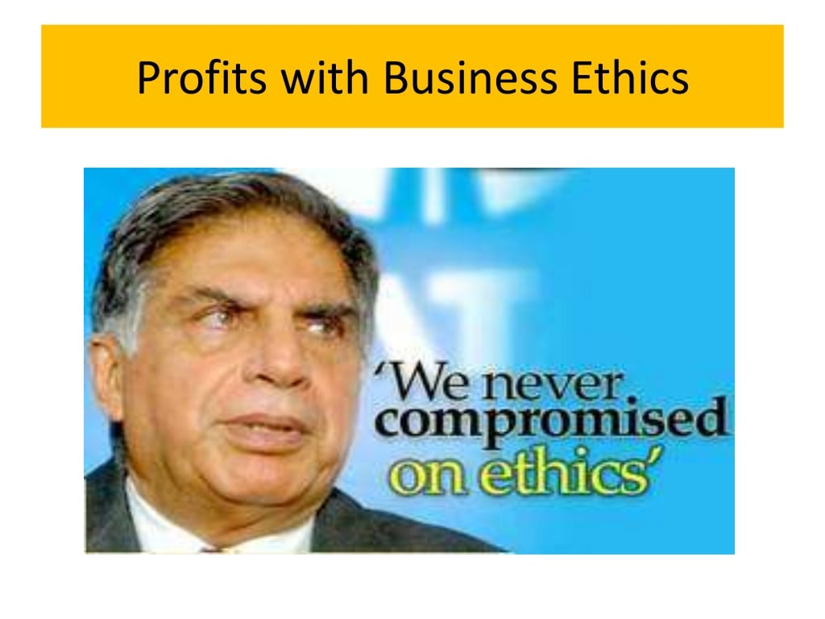

Slide 14
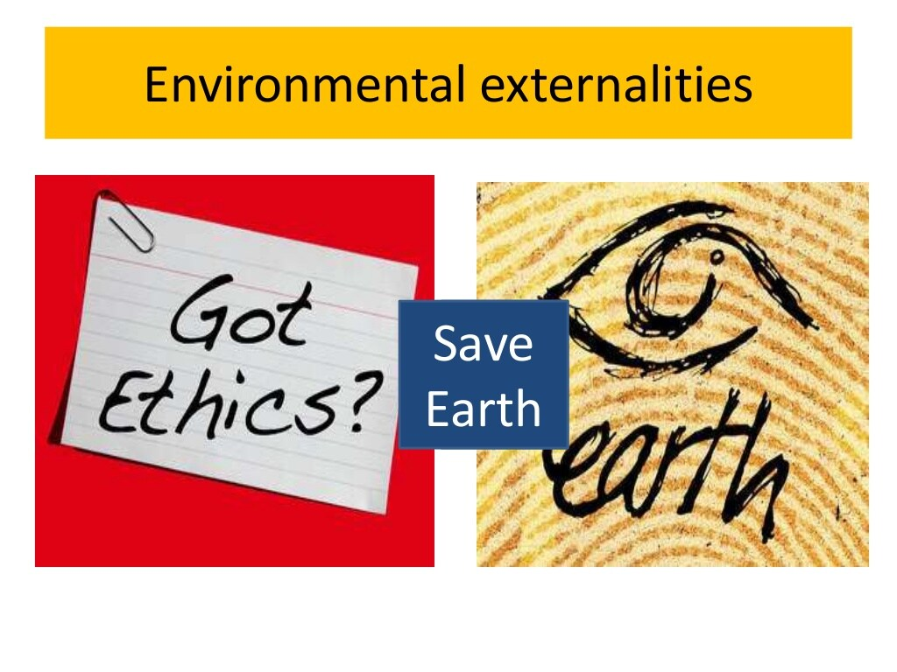

Slide 15
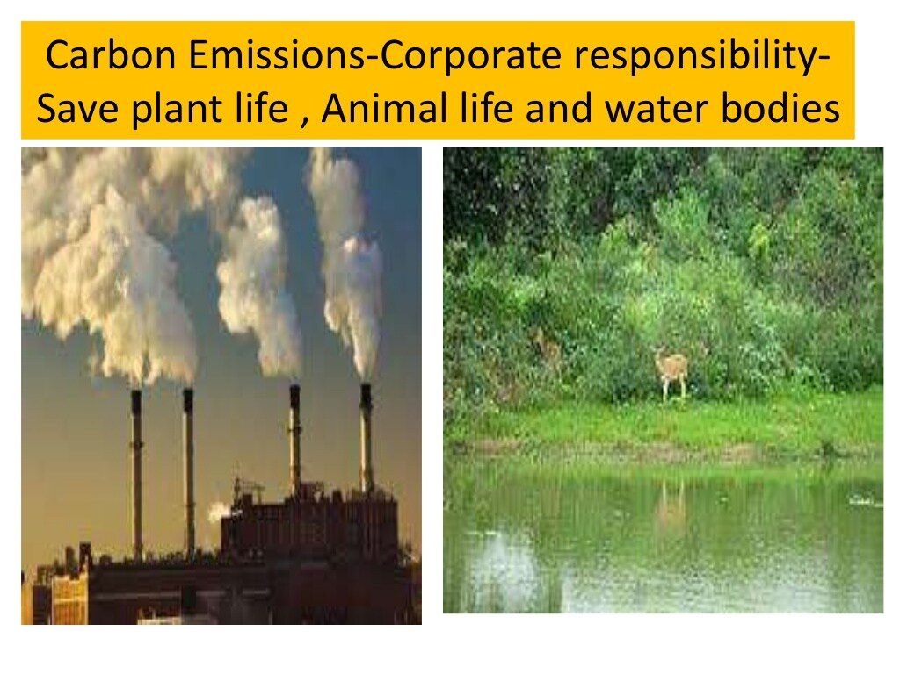

Slide 16
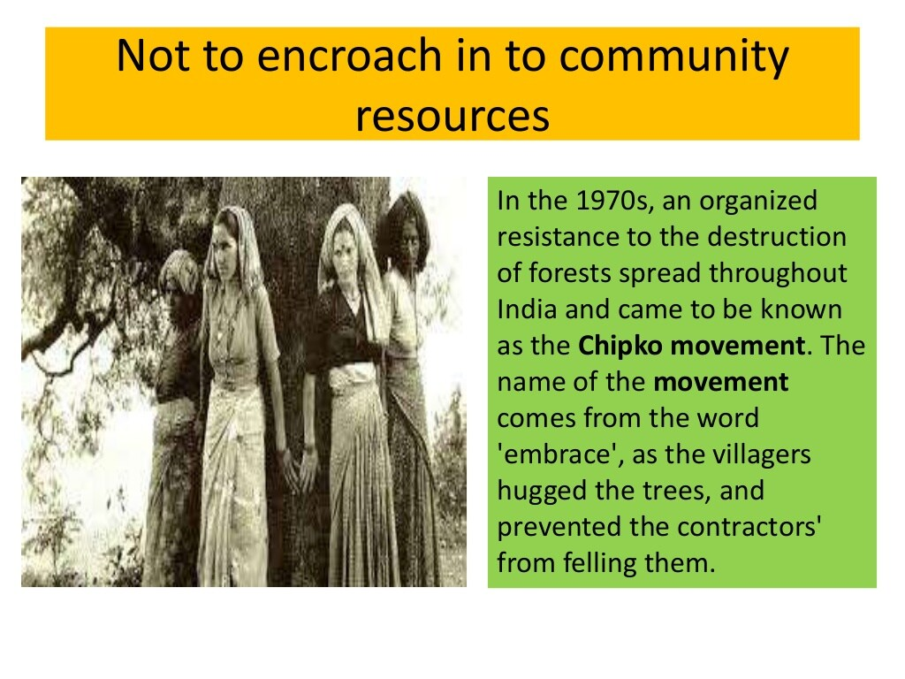

Slide 17
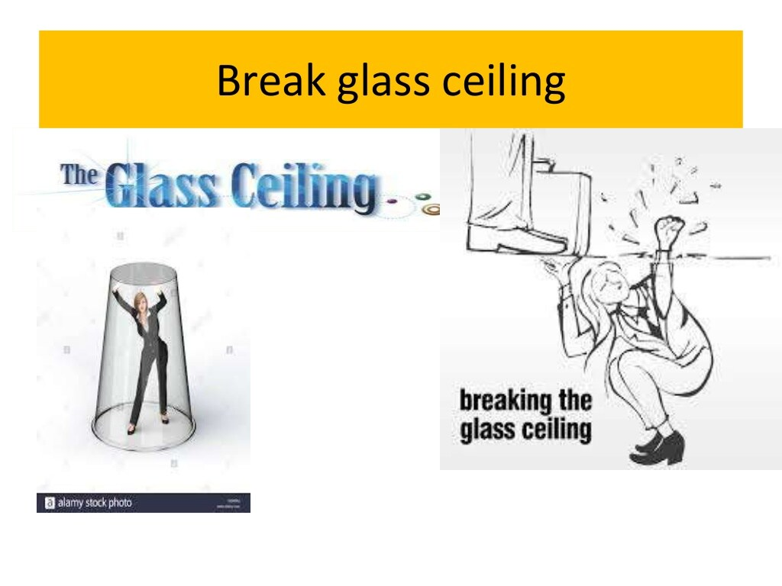

Slide 18
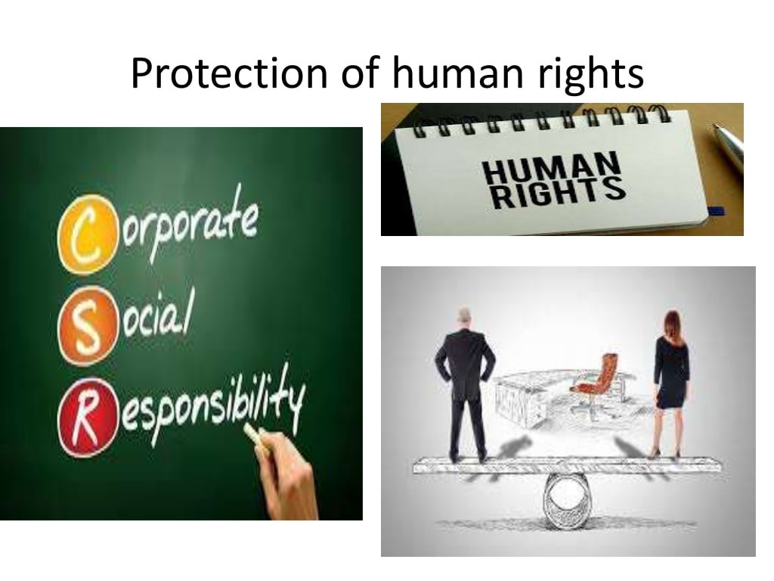

Slide 19


